Slide 1
Object Oriented Programming II
Monday 10th December 2024

Slide 2
OOP 2 - Herhaling
- Frontend vs Backend ?
Frontend vs Backend Technologies?
Full Stack Developers?
- API & Endpoints?

Slide 3

Types of API’s

Slide 4
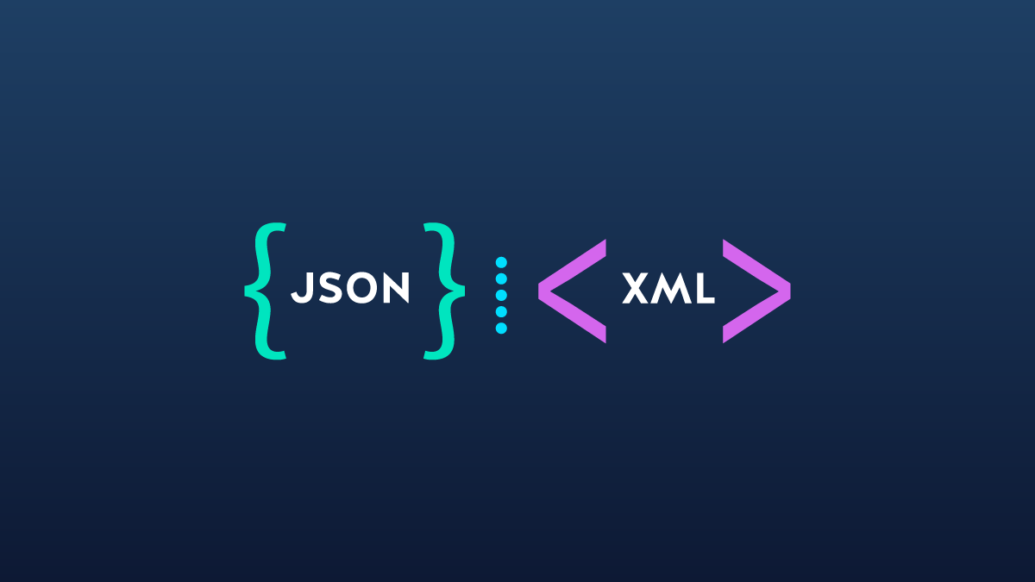
Languages used

Slide 5
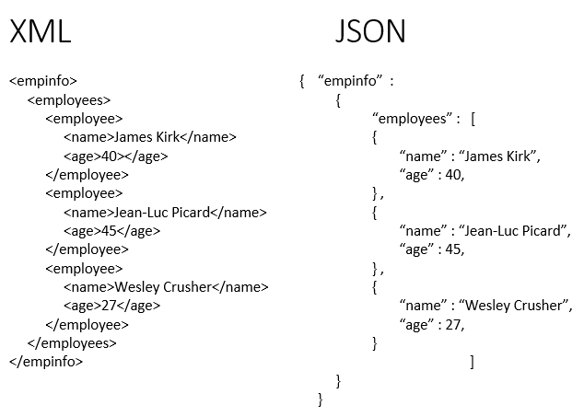
Example

Slide 6
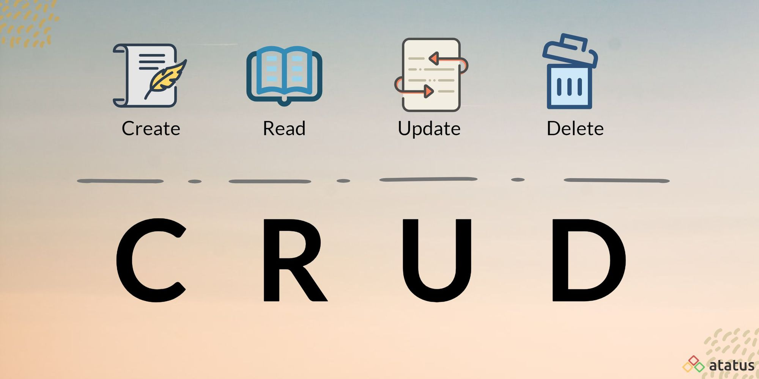
CRUD

Slide 7
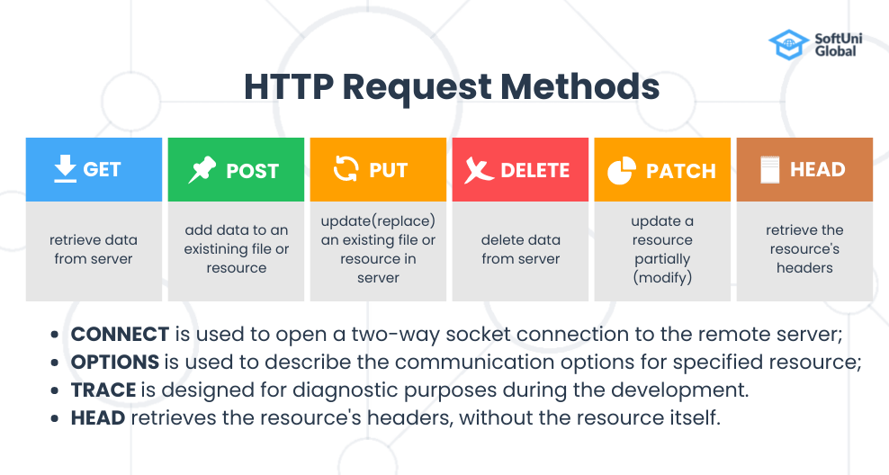
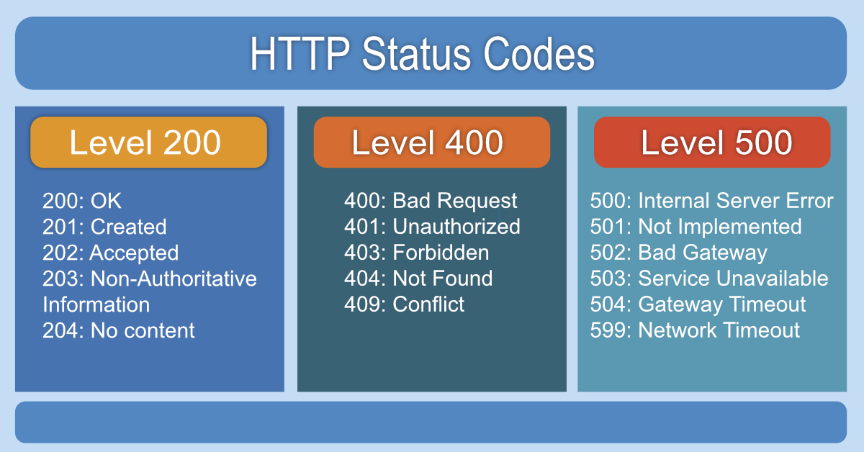
HTTP Methods & Statuses

Slide 8
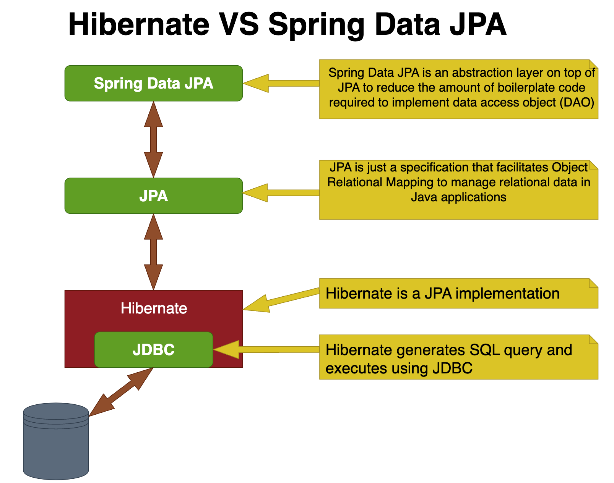
JPA & Hibernate (DB Communication) - ORM

Slide 9
Spring Initialzr
Spring Web
Spring Data JPA
H2 Database

Slide 10
Vragen?

